Slide 1
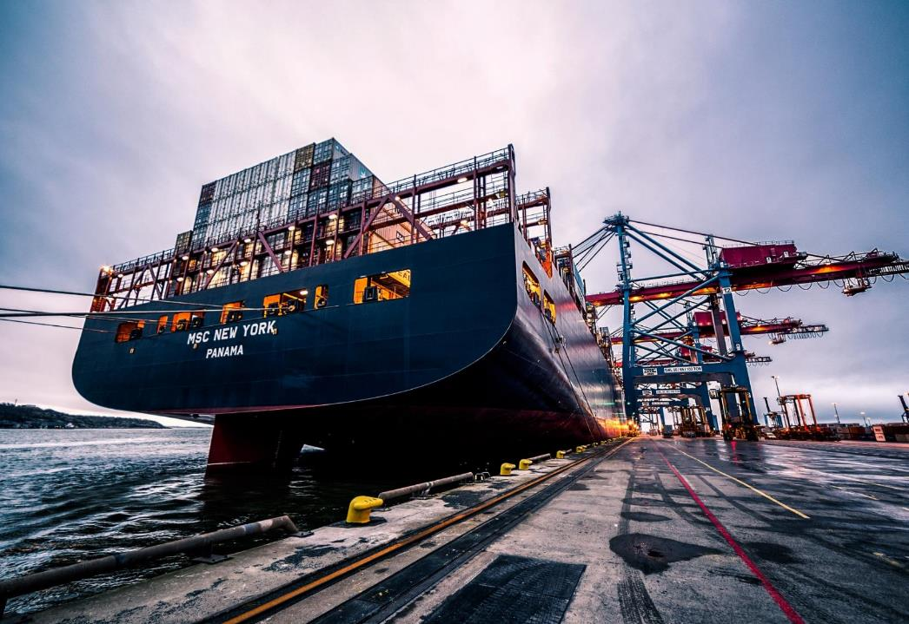
Who am I
I am Ayaz Salar
SEO & Digital Marketing Expert with more than 10 years experience in marketing
Versatile, Intellectual and Website project performer
Committed, Creative and innovative
Result oriented and ROI focused
Notes:
Links:
https://www.pexels.com/photo/black-sail-ship-on-body-of-water-906982/

Slide 2
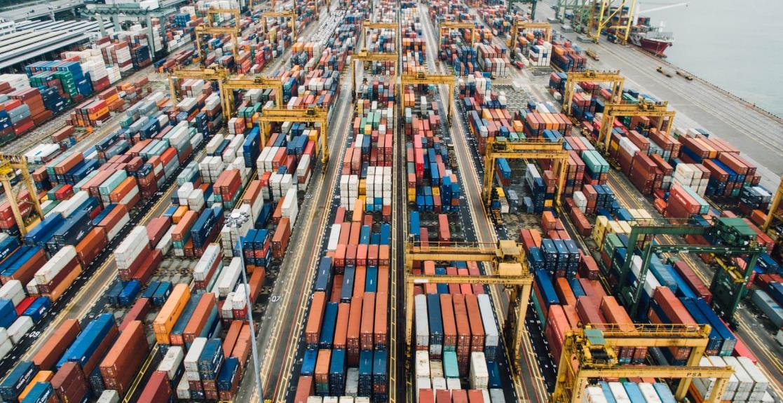
My Achievements
No: | Website | Keyword | Position
1 | Junebugweddings.com | Professional wedding photography | 3rd
2 | Marion.com | Digital marketing agency | 4th
3 | Proflowers.com | Order flowers online | 2nd
4 | interim-x.com | Interim management provider | 3rd
5 | Landandfarm.com | Ranches for sale houston | 5th
6 | Marianasir.com | Latest Pakistani fashion | 7th
7 | Digitizingusa.com | Digitizing Services in USA | 2nd
Notes:
Links:
https://unsplash.com/photos/fN603qcEA7g

Slide 3
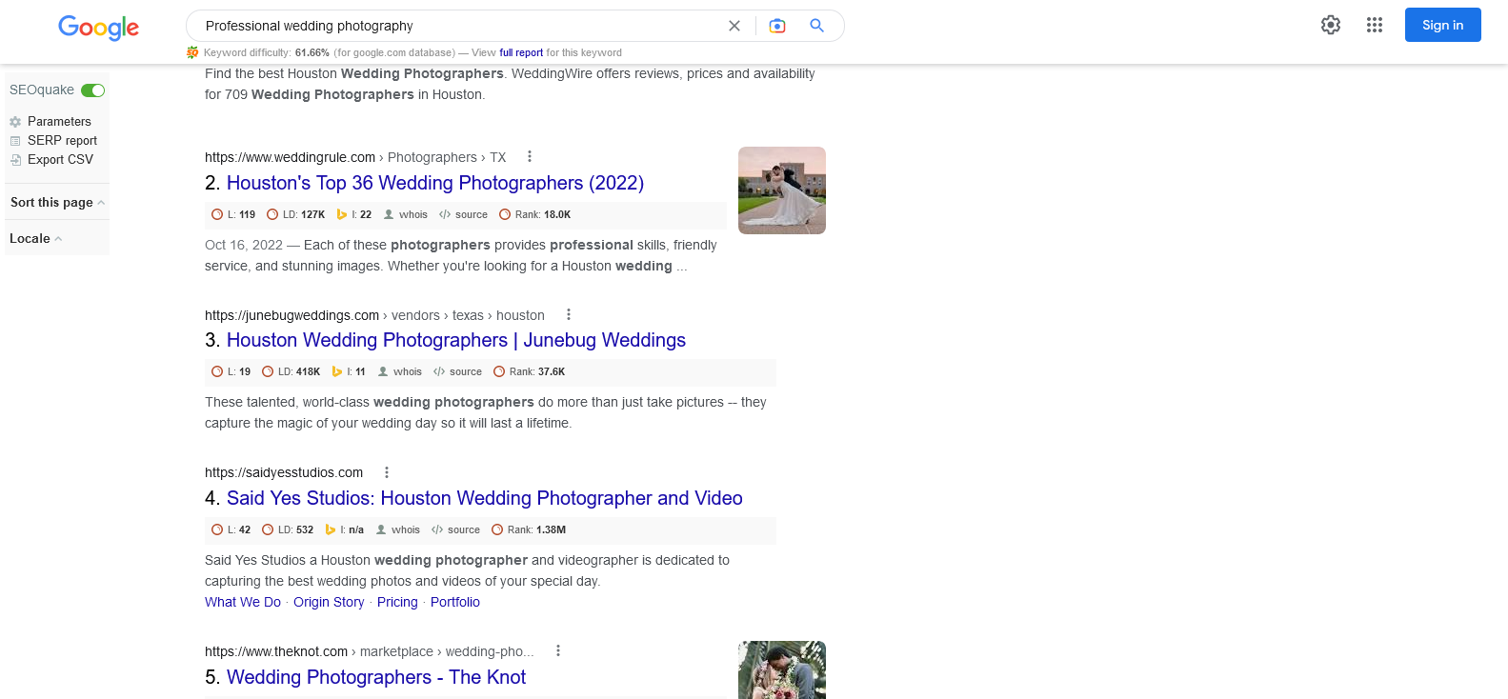
Junebugweddings.com | Professional wedding photography
Notes:
Links:
https://www.pexels.com/photo/assorted-color-trailer-boxes-2881632/

Slide 4
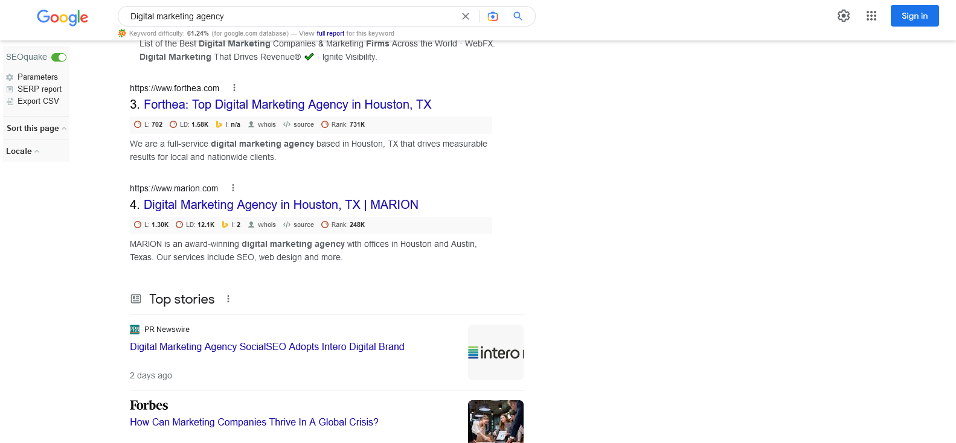
Marion.com | Digital marketing agency
Notes:
Links:
https://www.pexels.com/photo/assorted-color-trailer-boxes-2881632/

Slide 5
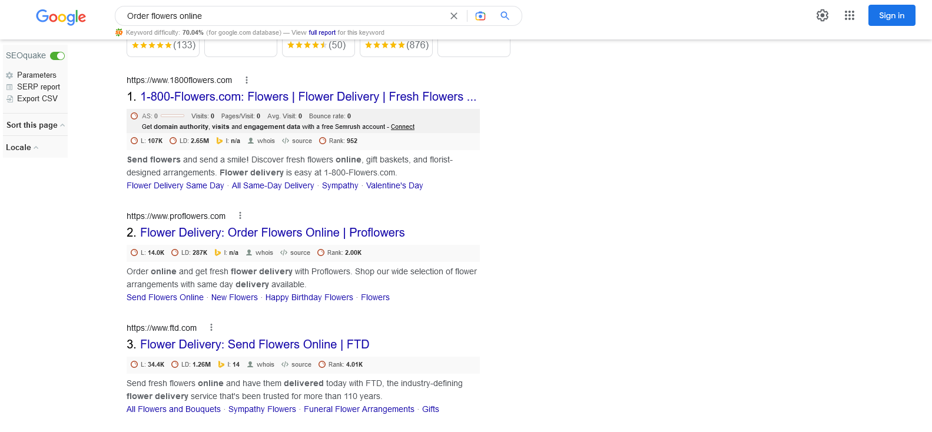
Proflowers.com | Order flowers online
Notes:
Links:
https://www.pexels.com/photo/assorted-color-trailer-boxes-2881632/

Slide 6
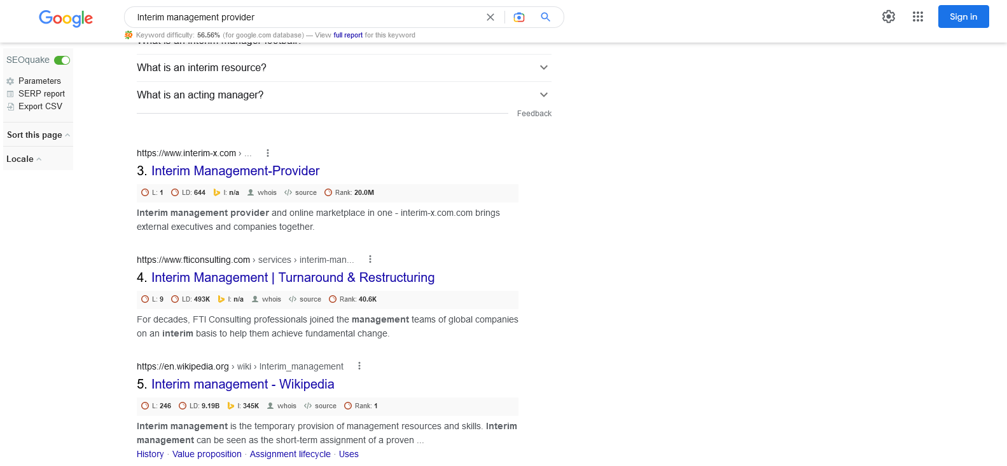
interim-x.com | Interim management provider
Notes:
Links:
https://www.pexels.com/photo/assorted-color-trailer-boxes-2881632/

Slide 7
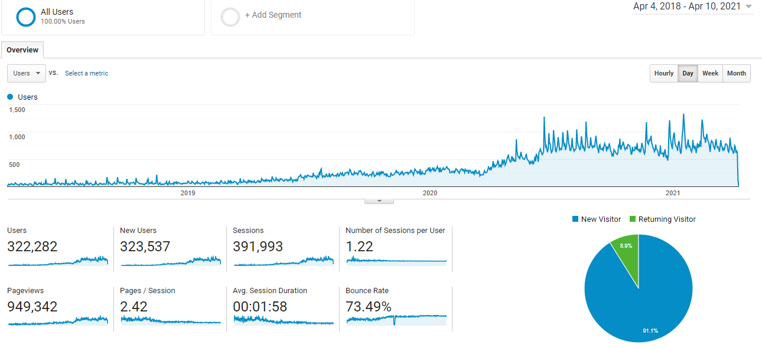
Analytics
As you can see in the screenshot. I installed Analytics in April 2018, from that time till April 2021 you can see the growth of website. When I started work on that website. It was penalized by Panda and penguin Algorithms because of their copy content and unnatural backlink profile. So my first action was change the website content and then I started to remove the unnatural, low authority and low quality backlinks. This process took 2 months and thanks to Allah my keywords started ranking in Google
Notes:
Links:
https://www.pexels.com/photo/assorted-color-trailer-boxes-2881632/

Slide 8
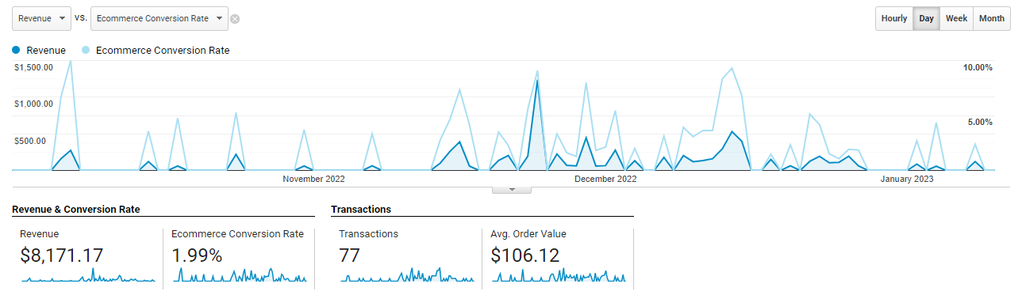
Ecommerce Conversion
Notes:
Links:
https://unsplash.com/photos/fN603qcEA7g

Slide 9
Why You Should Hire Me
I have vast experience of marketing Agencies and brands
Honestly, I possess all the skills and experience that you're looking for.
I understand problems and find solutions quickly
Most of my experience has been with European and American clients
Due to my marketing agency experience I am able to work in any niche or industry easily Which will help you now or in the future
Notes:
Links:
https://www.pexels.com/photo/men-s-wearing-black-suit-jacket-and-pants-937481/
https://www.pexels.com/photo/business-businessman-contemporary-corporate-532220/
https://www.pexels.com/photo/happy-ethnic-woman-sitting-at-table-with-laptop-3769021/
https://www.pexels.com/photo/cheerful-woman-smiling-while-sitting-at-table-with-laptop-4467687/

Slide 10
Why I am beneficial to the company
I have a strong technical and management skills
I can create long and short term goals and have ability to achieve them.
I can increase organic traffic as well as brand reputation of your website.
I can help you get the organic leads with a strong call to action
Notes:
Links:
https://www.pexels.com/photo/delivery-man-wearing-a-face-mask-carrying-boxes-4391478/
https://www.pexels.com/photo/delivery-man-wearing-a-face-mask-carrying-boxes-4391479/
https://www.pexels.com/photo/man-in-a-face-mask-handing-over-a-thermal-bag-to-another-man-4393668/
https://www.pexels.com/photo/man-wearing-a-face-mask-paying-for-pizza-delivery-4393444/

Slide 11
Thank You!
Notes:
Links:
https://www.pexels.com/photo/black-sail-ship-on-body-of-water-906982/

